Slide 1
eBAY PROJECT
By Danish Jamadar
Under Guidance of Mrs. Vaishali Sonawane Mam.

Slide 2
Introduction
ebay allows users to buy or view items via retail sales through online market places and websites in 190 markets worldwide.
eBay can be used by individuals, companies and governments to purchase and sell almost any legal, non-controversial item.

Slide 3
Modules
Authentication (Login)
Search
Cart (Add/Delete)
Category Navigation
Product Detail Page (PDP)
Localization
Navigation (Hover Menus)

Slide 4
Responsibilities
Create Test Plan
Create test cases
Automate test cases for each module
Create test analysis report
Find defects and create Defect Report

Slide 5
Overview
What is Ebay?
Ebay is an ecommerce platform that allows user to create their online store
It will help the user for Online selling and buying Products.

Slide 6
Modules Description
Module 1:Authentication (Login)
Checked all the functionalities on Sign in page which included personal info as email address, password.
Module 2 : Search
Verified the product search functionality including search bar, auto-suggestions, and search results display.
Module 3 : Cart (Add/Delete)
Checking add to cart, remove from cart and view cart summary functionalities whether it updating or not correctly.

Slide 7
Module 4 : Category Navigation
Checking functionalities of "Shop BY Category " and "All Categories" for Searching product for shopping
Module 5 : Product Detail Page
To check product detail with it's Description is displayed on new tab
Module 6 : Localization
Checking functionality to change language and country as per particular country flag selection
Module 7 : Navigation (Hover Menus)
Checking different types of category by scrolling mouse

Slide 8
DEFECTS
While Executing Login Authentication, after submitting password every time it should ask for OTP for Authentication but it works only once or twice.
We can't Change Language from English to Hindi

Slide 9
Defect identifier :- B_001
Ø Defect summary :- While Executing Login Authentication, after submitting password every timeit should ask for OTP for Authentication but it works only once or twice.
Ø Test Id :- TC_1
Ø Test case name :- TC_OTP_Authentication
Ø Module name :- Authentication
Ø Reproducible :- Sent OTP on Registered Phone Number
Ø Severity :- Medium
Ø Priority :- Medium
Ø Raised by :- Danish Jamadar
Ø Assigned to :- Reeva shah
Ø Date of assignment :- 19/8/2025
Ø Status :- Open
Ø Snap shots :-
Ø Fixed by :- developer
Ø Date of fixing :- 19/8/2025

Slide 10
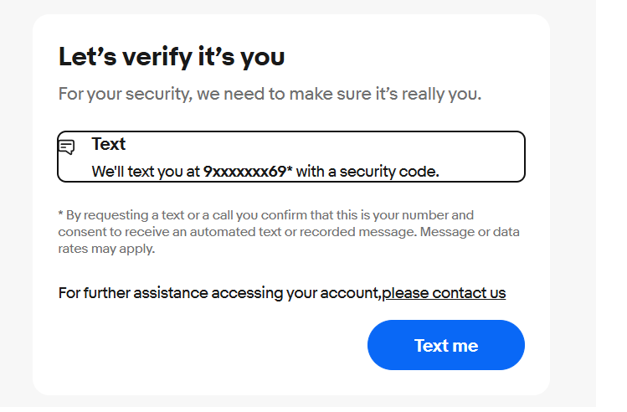

Slide 11
Defect identifier :- B_002
Ø Defect summary :- We can't Change Language from English to Hindi
Ø Test Id :- TC_1
Ø Test case name :- TC_Language
Ø Module name :- Localization
Ø Reproducible :-
Ø Severity :- low
Ø Priority :- Medium
Ø Raised by :- Danish Jamadar
Ø Assigned to :- Reeva shah
Ø Date of assignment :- 19/8/2025
Ø Status :- Open
Ø Snap shots :-
Ø Fixed by :- developer
Ø Date of fixing :- 19/8/2025

Slide 12
CHALLENGES
Challenges Faced :
Found difficulties While finding and Handling Unique Locators.
While testing the Sign In page, eBay sometimes triggered additional authentication steps.
While running all test cases at one time due to synchronization failure code gets stuck in middle

Slide 13
Experience
Gained hands-on experience in automation testing using Selenium with TestNG, including:
Designing robust and reusable test scripts.
Implementing assertions for validation.
Effectively handling implicit waits for dynamic elements.
Identified and reported multiple defects during both manual and automation testing, which enhanced my bug reporting and documentation skills.
Improved test case writing skills by analyzing all possible input combinations and scenarios.

Slide 14
THANK YOU!!!!

